Slide 1
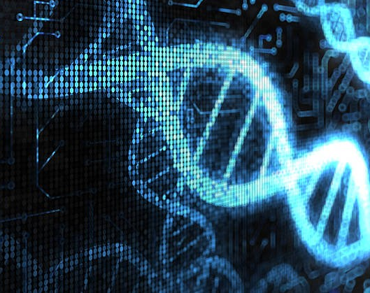
UMGC BIOT 670I Fall 2023 Capstone Project Status Update Group 3 Kevin Scaife, Runyu Wu, Priscilla Do Amaral, Anthony Ford, Aieman Zehra Ontologies
Notes:
Introductions for any newcomers (e.g., Prof. Rumpf)

Slide 2

Agenda
1
Project Overview and Goals
2
Core Functionality and GUI Development
3
Ontology Research and Incorporation
4
Next Steps and Challenges
Notes:
Kevin to go over agenda.

Slide 3

Project Overview and Goals
1
Notes:
We’ll start with the agreed upon project overview based on discussions with Dr. Day from Lab Ally and our groups determined scope and goals for the project as a whole.

Slide 4
Project Overview
Design an external application to “checkout” files from CERF, assign ontologies, and “check” the files back into CERF.
Bypass the currently non-functional CERF ontology manager
Allow for standardized ontology assignment to data used by different industries
Core functionality
Assign ontology terms (inserting into document) from standardized lists of terms
Save a log of changes (.csv)
Application will include a GUI to enable selection of ontologies from a list
Extensive research is needed for determining industry-relevant data and corresponding ontologies that would effectively categorize the data
Project was split into several components to distribute the work
Main application that accomplishes the core ontology assignment functionality
Ontology research and incorporation
GUI development

Slide 5
Project Goals
External application will first be designed to add ontology terms to text-based bioinformatics files (e.g., FASTA or SAM) based on preexisting ontologies from well-defined ontology repositories, specific to the industry to which the data belongs.
The system must be sufficiently modular that it could be used for more than one industry standard ontology, allow for one or more ontology terms, and must copy that ontology tag into a metadata field or into the body of the file
Appropriate documentation in the form of a user manual/tutorial

Slide 6

Core Functionality and GUI Development
2
Notes:
I’ll now pass it over to Runyu and Tony to discuss the progress that has been made on the core functionality of the application

Slide 7
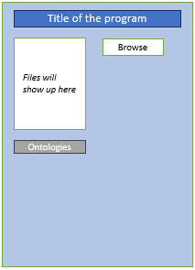
Core Functionality
Basic Functionality
Ontology Functionality
Detailed Purpose: TBD
Purpose: write the Ontology to corresponding place in the file
Input: 4 types of bioinformatic file
Output: modified file and their backups
Purpose: collect users input of Ontology
The functions in BLUE BOX have Version0
Github (RunyuWU branch):
https://github.com/EvanWu19/ExternalOntologyforCERF
Purpose: log the Ontology modification to ontology_changes.csv for CERF to use
Output: update ontology_changes.csv
Notes:
Runyu to present

Slide 8
Core Functionality – CERF-GUI-Programs
GUI – implemented via Python Flet – interface between CERF and functional programs
GUI accessed manually once a file(s) referencing an ontology is checked out from CERF
GUI to pass control to corresponding functional program based upon file type (e.g., Fasta, SAM, GFF3, VCF)
GUI contents redisplayed reflecting functional programming ontology modifications
Modifications returned to CERF – Check in manually
Notes:
Tony to present
Automatically opening the program after checkout is a stretch goal

Slide 9
GUI Development
Possible Flow Logic:
Title of the program
Title of the program
Title of the program
Files will show up here
Browse
Test.txt
Test2.txt
Browse
Test.txt
Test2.txt
Browse
Ontologies
Ontologies
Ontologies
Ontology chosen
Ontology chosen
Test.txt
Add
Add
Test.txt
1)Choose File Type (FASTA, SAM, VCF, GFF3) → key parameters in GUI will be Filename and File Type
2)Click on a Button to run specific ontology update program (FASTA, SAM, VCF, GFF3) based upon the File Type displayed → Logic built into the GUI…
3)Once update program runs → Redisplay GUI with added / modified ontology
4)Control returned back to CERF – checked back in manually
Notes:
Priscilla to discuss figures – We working on creating a GUI using Flet. Flutter/Flet is new for us, and we have been learning on how to develop a GUI using this application.
The initial design is to have a browser button where the user can search for the file that have been checked out of CERF. The file will display in the left side box, the user will then click on the file to select and search for the ontology to be applied to that file. Once the ontology is added, the file will then appear in the bottom box.

Slide 10

Ontology Research and Incorporation
3
Notes:
Tony to pass it over to Priscilla to discuss pharmaceutical industry data

Slide 11
Ontology Research and Incorporation
Food industry data
Focusing on biological/bioinformatics data
FASTA files are used to store nucleotide and protein sequences that range in size from single genes/proteins all the way to genomes/proteomes
Eukaryotic vs prokaryotic genomes and production organism vs probiotics
Gene clusters, housekeeping genes, specific motifs
Clinically relevant tags (e.g., allergenic epitopes and specific binding domains/activity)
FASTQ files contain quality data for sequencing read data
SAM files can be used for single sequence alignments and genome-wide association studies (single or multiple sequence alignments)
GFF (General Feature Format) stores information fields of a genome (e.g., SNPs)
VCF (Variant Call Format) stores variation data for gene sequences
Ontologies
Gene Ontology – GO
Protein Ontology – PRO
Taxonomy - NCBITaxon
Notes:
Kevin

Slide 12
Ontology Research and Incorporation
Focusing on pharmaceutical industry data
Research and Development
FASTA, FASTQ, SAM, Genbank
GTF file to hold information about gene structure.
GFF text file to hold information and feature that can be applied to a nucleic acid or protein sequence (e.g. CDS, microRNAs, binding, domains, ORFs)
Ontologies
Gene Ontology – GO
Protein Ontology – PRO
Notes:
Priscilla – Some of the files used in pharmaceutical industry for bioinformatic data are FASTA, FASTQ, SAM, Genbank and the purpose is the same as mentioned in the previous slide. In addition, there is GTF file that are used for gene structure information and GFF files that are used for nucleic acid and protein sequences.
What differs from the food industry is the application and use of the data is focusing on understand aspects/cause disease and drug development.
Some of the ontologies that can be used by the pharmaceutical industry is the Gene Ontology – which provides vocabularies related to gene products, molecular function, cellular components; and Protein Ontology – which provides ontology representation of protein-related entities and the relationship between them.

Slide 13
Ontology Research and Incorporation
Gene Ontology (GO)
Designed to synthesize orthologous biological functional of genes and proteins
Formal representation of data within the biological domain
Molecular Function (MF)
Cellular Compartment (CC)
Biological Process (BP)
Three separate root ontologies that are not related using is a terminology
Can be related by part of and regulates terminology
Example GO Annotation: Cytochrome C
Oxidoreductase activity (MF) : Mitochondrial intermembrane space (CC) : Oxidative phosphorylation (BP)
Dynamic ontology
Updated weekly
Notes:
Kevin
GO won’t be used directly but through Bioportal

Slide 14
Ontology Research and Incorporation
BioPortal
Repository for biomedical ontologies and terminologies
Ontologies are categorized into various domains or subject areas. These domains include genomics, clinical informatics, anatomy, pharmacology, epidemiology, and more.
Mostly available in OWL and OBO formats
Example sequence_feature: gene: proten_coding_gene: AANATL2 (fruit fly)
Provides APIs and web services that allow users to integrate their subsets with other software tools and applications
NCBO widgets
Term selection: add a text field to our application window that will let users enter a term from a controlled vocabulary (e.g., terms from a single ontology)
Ontology search: add to your Web site a search box that searches a specific BioPortal ontology
Track updates (RSS Feed Widget): live feed of all the changes to the ontology of interest
Notes:
Aieman
Possibly add an example?

Slide 15
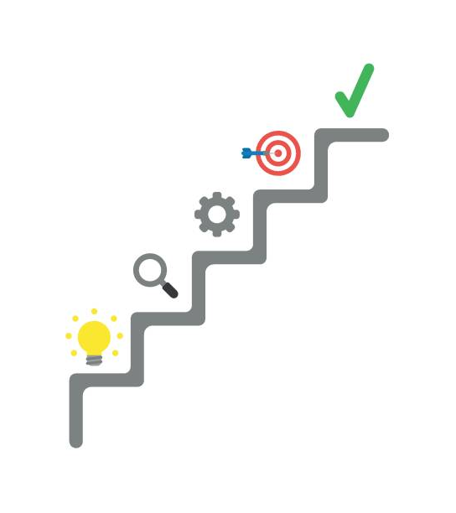
Next Steps, Scope Changes, and Challenges
4

Slide 16
Next Steps and Challenges
Next steps
Test Bioportal API to determine compatibility with our Python-based programs
Add functionality to include multiple ontologies
Challenges
Adapting the assignment of ontology terms for multiple different bioinformatics files
Connect a live API to update Bioportal ontologies
Notes:
Kevin

